Slide 1

GridaEnergy
Data Field 분석
(Parser)
2019. 09. 04.
에너지시스템연구실
김낙우

Slide 2
Contents
(예상)시스템 구성
전체 데이터 구성
각 필드별 구성
주요 데이터 필드
향후 일정 및 논의

Slide 3

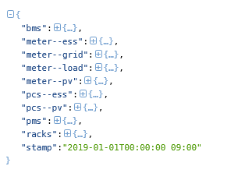
(예상) 시스템 구성
3: meter-load
Load
M
7: PMS
Inverter
PCS
2: meter-grid
M
6: pcs-pv
5: pcs-ess
M
1: meter-ess
0: BMS
M
4: meter-pv
8: rack
meter-**: 한전관리용 데이터
그외 : PCS 측정 관리용 데이터

Slide 4
전체 데이터 구성
{"bms":{"1803":{"Tmp":22,"TmpMax":24.5,"TmpMin":17,"TmpMinMaxLoc":{"max":2,"min":2},"VCell":3.446,"VCellMax":3.465,"VCellMin":3.41,"VCellMinMaxLoc":{"max":2,"min":1}},"1805":{"Hb":0,"NRack":4,"NRackCellBal":0,"NRackDsOn":4,"NRackFanOn":0,"NRackFault":0,"NRackOn":4,"NRackWarn":0},"1823":{"Bsc":0,"Contactor":"NONE","Hb":0,"ManMode":0,"Rst":"NONE","Sleep":0,"StController":"SHUTDOWN"},"1825":{},"802":{"A":0,"AChaMax":541.2,"ADisChaMax":244.7,"EvtVnd1":[],"EvtVnd2":[],"EvtVnd3":[],"EvtVnd4":[],"SoC":5,"SoH":97.5,"StEvtVnd":{"charge status":"IDLE","comm error":"NORMAL","contactor control":"NORMAL","fault":"NORMAL","high soc alram":"NORMAL","low soc alram":"NORMAL","online":"ONLINE","under balance":"NORMAL","warning":"NORMAL"},"StVnd":"NORMAL","V":820.3,"WChaMax":444000,"WDisChaMax":200800}},"meter--ess":{"214":{"A":0,"AphA":0,"AphB":0,"AphC":0,"Hz":0,"PF":0,"PPVphAB":0,"PPVphBC":0,"PPVphCA":0,"PhV":0,"PhVphA":0,"PhVphB":0,"PhVphC":0,"TotVAhImp":0,"TotWhExp":0,"TotWhImp":0,"VA":0,"VAR":0,"VARphA":0,"VARphB":0,"VARphC":0,"VAphA":0,"VAphB":0,"VAphC":0,"W":0,"WphA":0,"WphB":0,"WphC":0}},"meter--grid":{"214":{"AphA":0,"AphB":0,"AphC":0,"Hz":0,"PF":0,"PPVphAB":0,"PPVphBC":0,"PPVphCA":0,"PhVphA":0,"PhVphB":0,"PhVphC":0,"TotVAhImp":0,"TotWhExp":0,"TotWhImp":0,"VAR":0,"W":0}},"meter--load":{},"meter--pv":{"214":{"A":0,"AphA":0,"AphB":0,"AphC":0,"Hz":60.01651,"PF":0,"PPVphAB":385.35727,"PPVphBC":385.22623,"PPVphCA":383.4875,"PhV":222.12413,"PhVphA":222.05371,"PhVphB":222.7572,"PhVphC":221.56148,"TotVAhImp":137521260,"TotWhExp":0,"TotWhImp":136852060,"VA":0,"VAR":0,"VARphA":0,"VARphB":0,"VARphC":0,"VAphA":0,"VAphB":0,"VAphC":0,"W":0,"WphA":0,"WphB":0,"WphC":0}},"pcs--ess":{"001":{"Vr":{"param":1003,"sw":10001}},"1113":{"AphA":8.8,"AphB":8.7,"AphC":8.7,"DCV":820.3,"Hz":60.134,"PPVphAB":382,"PPVphBC":384,"PPVphCA":383.4,"StPcsVnd1":["CB1 ON","MC4 ON","CB3 ON","","","System On"],"WHCha":134198492.8,"WHDisCha":115206648},"1123":{"VarRem":0,"WRem":0},"113":{"AphA":7.6,"AphB":7.6,"AphC":7.7,"DCA":0.3,"DCV":821,"DCW":200,"Evt1":[],"EvtVnd1":[],"EvtVnd2":[],"EvtVnd3":[],"EvtVnd4":[],"Hz":60.138,"PF":0.02,"PPVphAB":441.1,"PPVphBC":440.5,"PPVphCA":446.2,"StVnd":"Stand-by","TmpCab":21,"TmpSnk":27,"VAr":5700,"W":0},"123":{"Conn":"CONNECT"}},"pcs--pv":{},"pms":{"1020":{"StCommVnd":{"bms":true,"meter--ess":false,"meter--grid":false,"meter--pv":true,"pcs--ess":true}}},"racks":{"0":{"1803":{"Tmp":22.5,"TmpMax":24,"TmpMin":18,"TmpMinMaxLoc":{"max":32,"min":2},"VCell":3.446,"VCellMax":3.463,"VCellMin":3.41,"VCellMinMaxLoc":{"max":1,"min":234}},"1805":{"NModOn":65535},"802":{"A":0,"AChaMax":148.4,"ADisChaMax":69.6,"EvtVnd1":[],"EvtVnd3":[],"SoC":5,"SoH":97.5,"StEvtVnd":{"bpu fan feedback":"OFF","cell balancing":"NORMAL","charge status":"IDLE","disconnect switch feedback":"ON","every mbms turned on":"ON","fan status":"OFF","fault":"NORMAL","high soc alram":"NORMAL","low soc alram":"NORMAL","main contactor feedback":"ON","main contactor status":"ON","main contactor - feedback":"ON","main contactor - status":"ON","module fan feedback":"OFF","online":"ONLINE","precharge contactor status":"OFF","warning":"NORMAL"},"StVnd":"NORMAL","V":820.3,"W":0,"WChaMax":121800,"WDisChaMax":57100}},"1":{"1803":{"Tmp":22.5,"TmpMax":24.5,"TmpMin":17,"TmpMinMaxLoc":{"max":29,"min":2},"VCell":3.447,"VCellMax":3.465,"VCellMin":3.407,"VCellMinMaxLoc":{"max":226,"min":152}},"1805":{"NModOn":65535},"802":{"A":0,"AChaMax":148.4,"ADisChaMax":61.1,"EvtVnd1":[],"EvtVnd3":[],"SoC":5,"SoH":98,"StEvtVnd":{"bpu fan feedback":"OFF","cell balancing":"NORMAL","charge status":"IDLE","disconnect switch feedback":"ON","every mbms turned on":"ON","fan status":"OFF","fault":"NORMAL","high soc alram":"NORMAL","low soc alram":"NORMAL","main contactor feedback":"ON","main contactor status":"ON","main contactor - feedback":"ON","main contactor - status":"ON","module fan feedback":"OFF","online":"ONLINE","precharge contactor status":"OFF","warning":"NORMAL"},"StVnd":"NORMAL","V":820.4,"W":0,"WChaMax":121800,"WDisChaMax":50200}},"2":{"1803":{"Tmp":22.5,"TmpMax":24,"TmpMin":18,"TmpMinMaxLoc":{"max":32,"min":1},"VCell":3.447,"VCellMax":3.461,"VCellMin":3.41,"VCellMinMaxLoc":{"max":1,"min":123}},"1805":{"NModOn":65535},"802":{"A":0,"AChaMax":148.4,"ADisChaMax":69.6,"EvtVnd1":[],"EvtVnd3":[],"SoC":5,"SoH":98,"StEvtVnd":{"bpu fan feedback":"OFF","cell balancing":"NORMAL","charge status":"IDLE","disconnect switch feedback":"ON","every mbms turned on":"ON","fan status":"OFF","fault":"NORMAL","high soc alram":"NORMAL","low soc alram":"NORMAL","main contactor feedback":"ON","main contactor status":"ON","main contactor - feedback":"ON","main contactor - status":"ON","module fan feedback":"OFF","online":"ONLINE","precharge contactor status":"OFF","warning":"NORMAL"},"StVnd":"NORMAL","V":820.4,"W":0,"WChaMax":121800,"WDisChaMax":57100}},"3":{"1803":{"Tmp":21.5,"TmpMax":23,"TmpMin":18.5,"TmpMinMaxLoc":{"max":30,"min":2},"VCell":3.447,"VCellMax":3.462,"VCellMin":3.423,"VCellMinMaxLoc":{"max":2,"min":238}},"1805":{"NModOn":65535},"802":{"A":0,"AChaMax":148.4,"ADisChaMax":69.6,"EvtVnd1":[],"EvtVnd3":[],"SoC":5,"SoH":98,"StEvtVnd":{"bpu fan feedback":"OFF","cell balancing":"NORMAL","charge status":"IDLE","disconnect switch feedback":"ON","every mbms turned on":"ON","fan status":"OFF","fault":"NORMAL","high soc alram":"NORMAL","low soc alram":"NORMAL","main contactor feedback":"ON","main contactor status":"ON","main contactor - feedback":"ON","main contactor - status":"ON","module fan feedback":"OFF","online":"ONLINE","precharge contactor status":"OFF","warning":"NORMAL"},"StVnd":"NORMAL","V":820.4,"W":0,"WChaMax":121800,"WDisChaMax":57100}}},"stamp":"2019-01-01T00:00:00 09:00"}

Slide 5
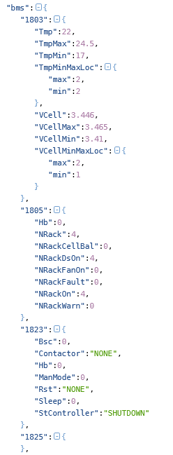
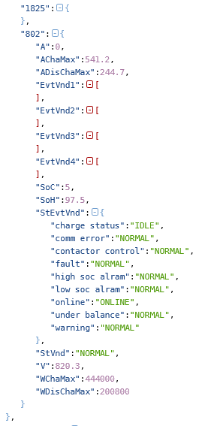
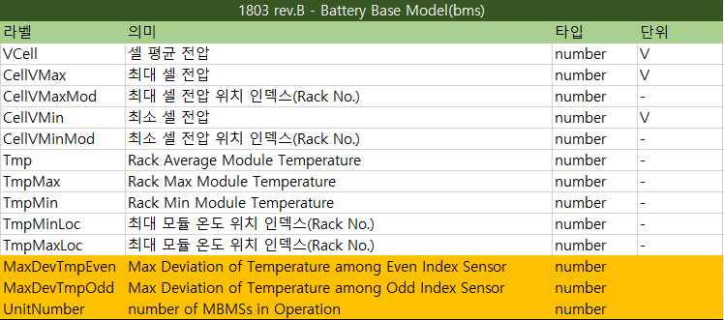
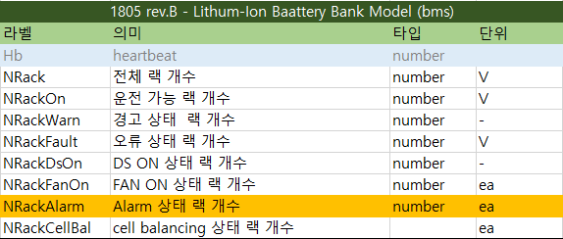
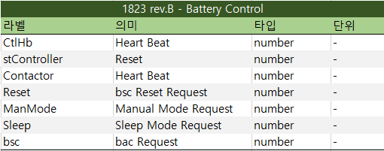
각 필드별 구성 (0 : BMS)

Slide 6
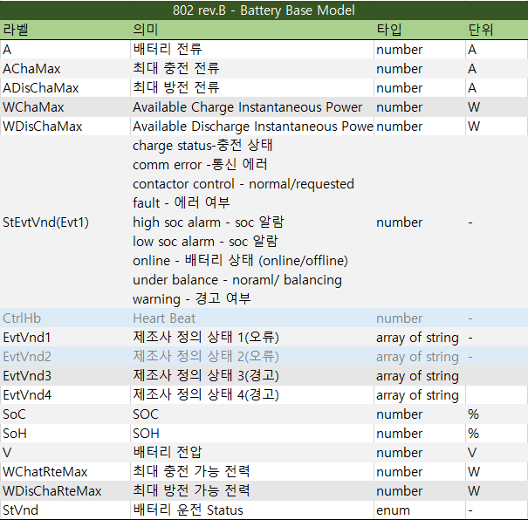
각 필드별 구성 (0 : BMS)

Slide 7
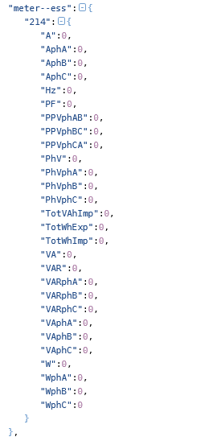
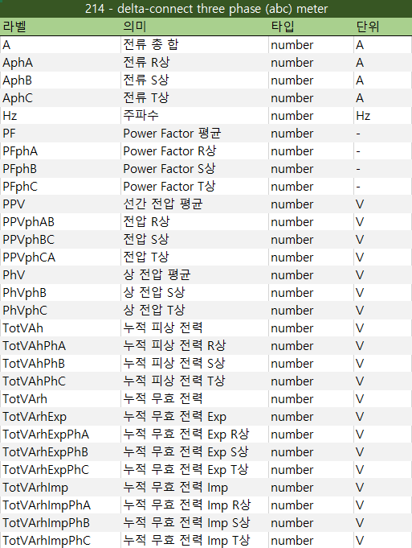
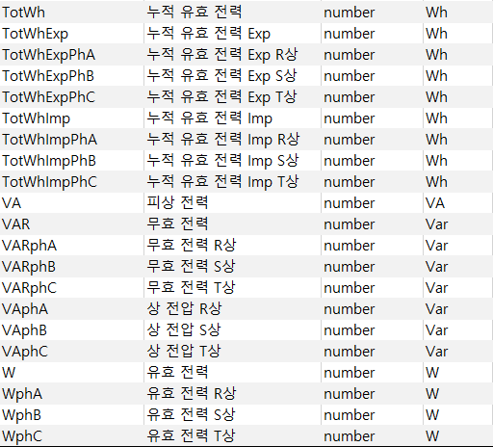
각 필드별 구성 (1 : meter--ess)

Slide 8
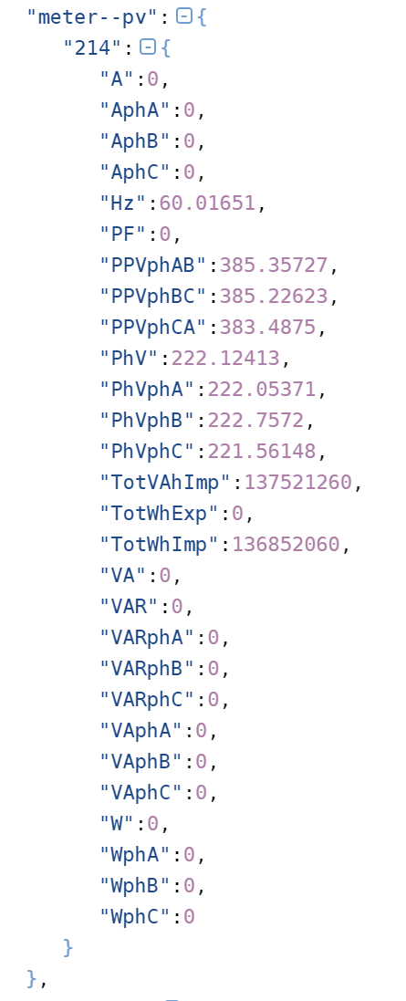
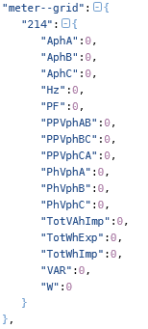

각 필드별 구성 (2,3,4 : meter—grid,load,pv)
*1 : meter—ess 필드 데이터 참조

Slide 9
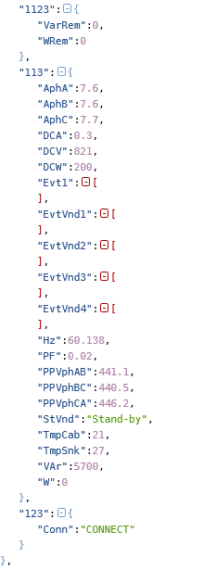
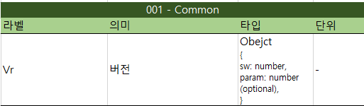
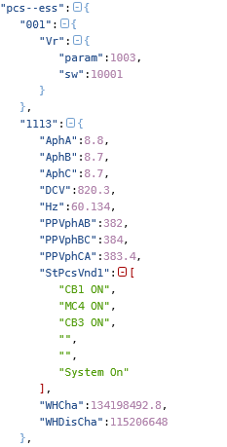
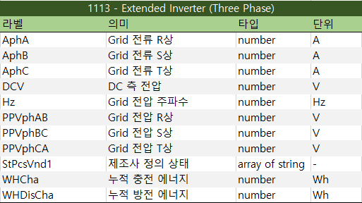

각 필드별 구성 (5 : pcs--ess)

Slide 10
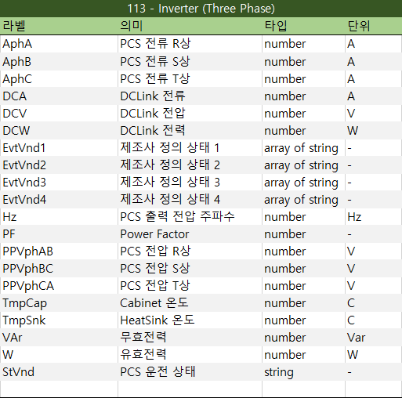
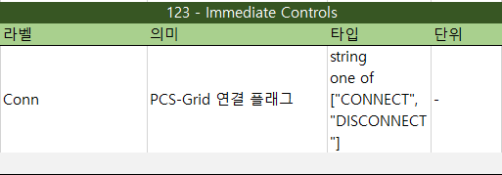
각 필드별 구성 (5 : pcs--ess)

Slide 11
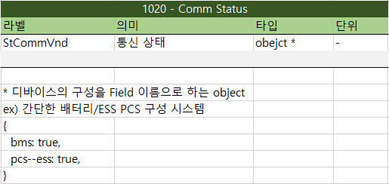
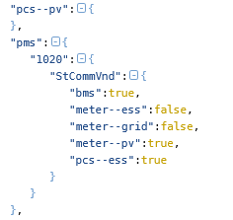
각 필드별 구성 (6,7 : pcs--pv,pms)

Slide 12
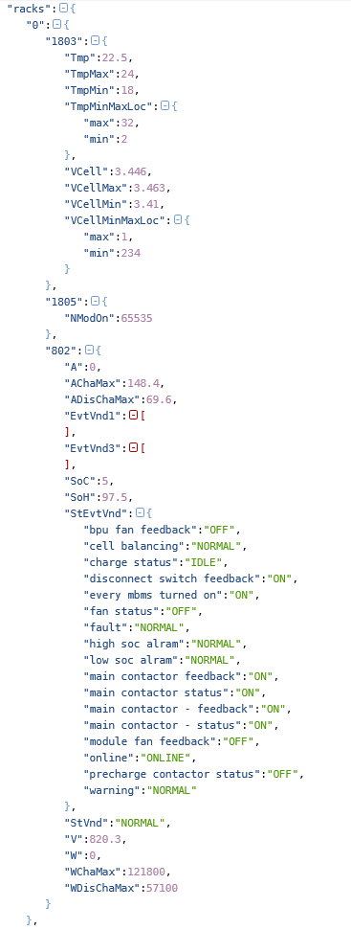
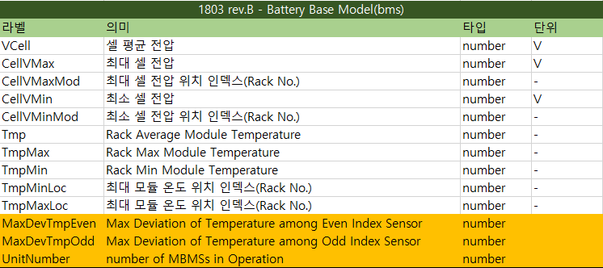

각 필드별 구성 (8 : rack)

Slide 13
각 필드별 구성 (8 : rack)

Slide 14
각 필드별 구성 (읽기)
항목 | 데이터 소스
ESS PCS 충전 전력 패턴 | ess.113.W if ess.113.W < 0 else 0
ESS PCS 방전 전력 패턴 | ess.113.W if ess.113.W > 0 else 0
PV 발전 전력 패턴 | pv.113.W -> meter-pv.214.W (?)
SOC | bms.802.SoC
ESS PCS 누적 충전 전력 | ESS PCS 충전 전력 패턴 적분¹⁾
ESS PCS 누적 방전 전력 | ESS PCS 방전 전력 패턴 적분¹⁾
PV 누적 발전 전력 | PV 발전 전력 패턴 적분¹⁾
1) 패턴의 모든 합을 시간당 DB 기록 횟수로 나눔 (Wh 단위)
ex) 5분 마다 DB에 기록할 경우 적분 값 = sum([금일 패턴…])/(60/5)

Slide 15
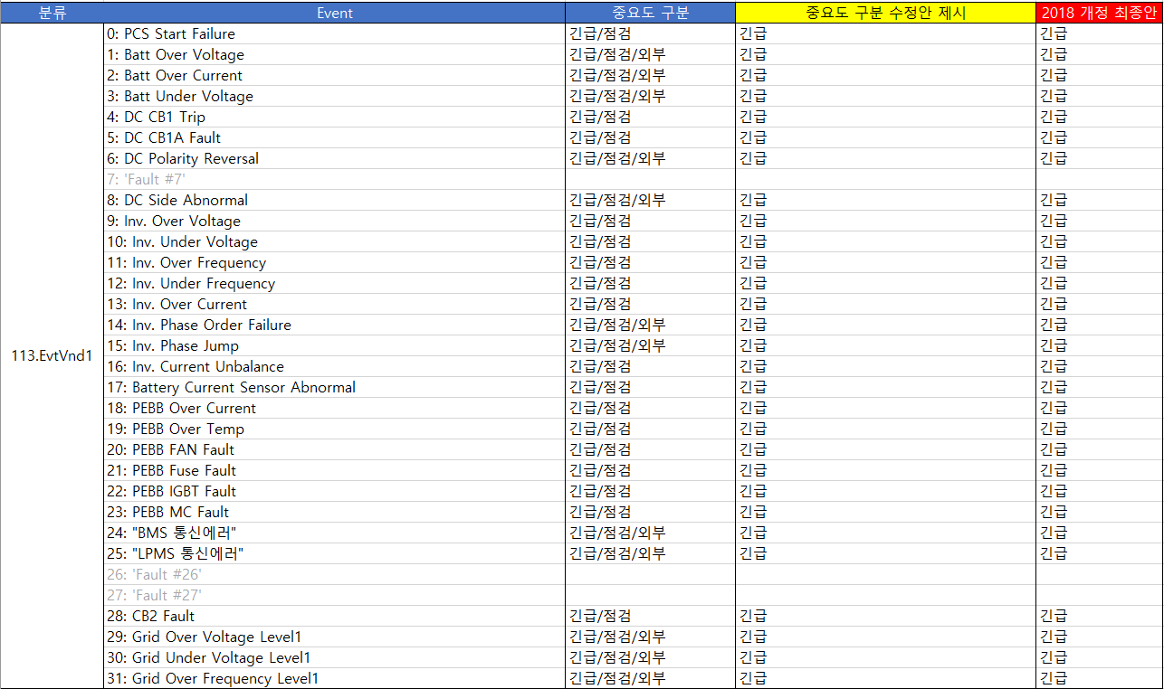
각 필드별 구성 (Event:PCS)
PCS
*EMS event_20181004_개정 최종안.xlsx 참고

Slide 16
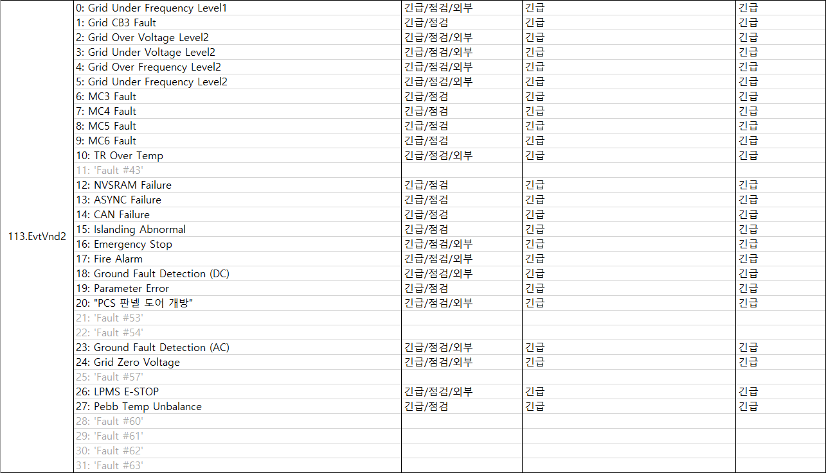
각 필드별 구성 (Event:PCS)
PCS
*EMS event_20181004_개정 최종안.xlsx 참고

Slide 17
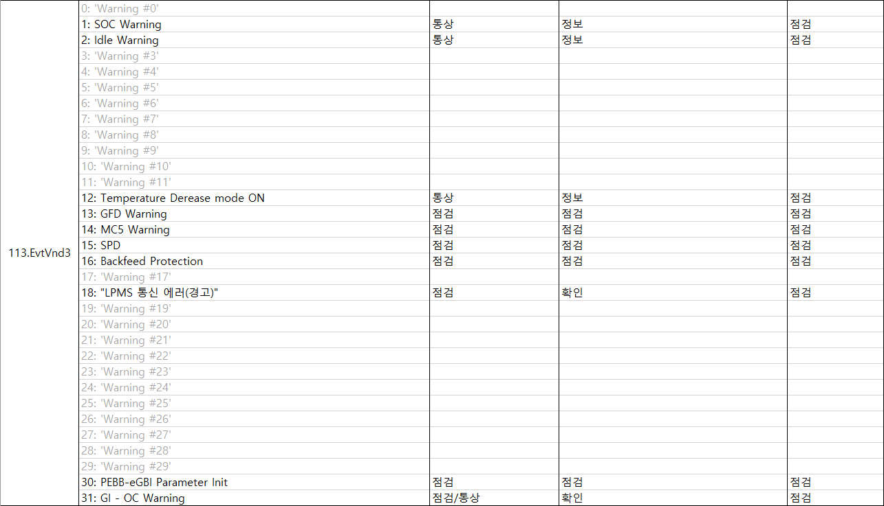
각 필드별 구성 (Event:PCS)
PCS
*EMS event_20181004_개정 최종안.xlsx 참고

Slide 18
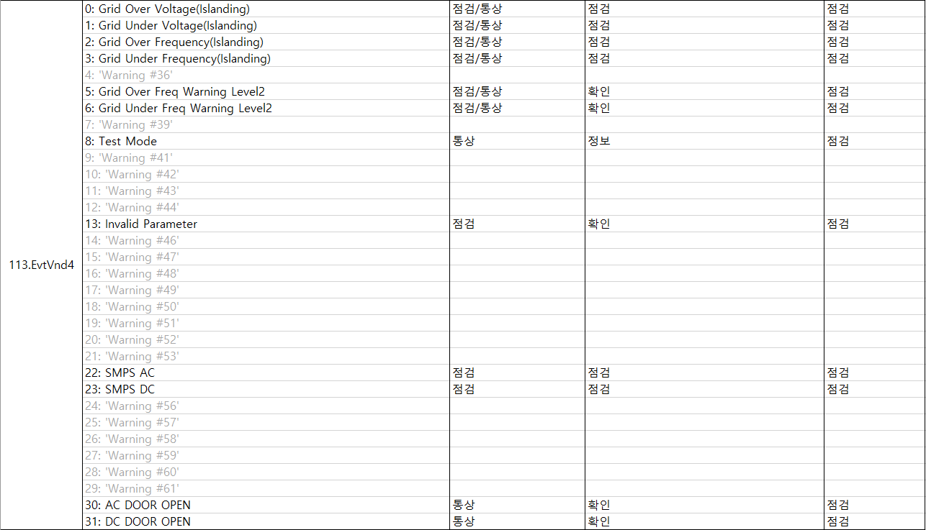
각 필드별 구성 (Event:PCS)
PCS
*EMS event_20181004_개정 최종안.xlsx 참고

Slide 19
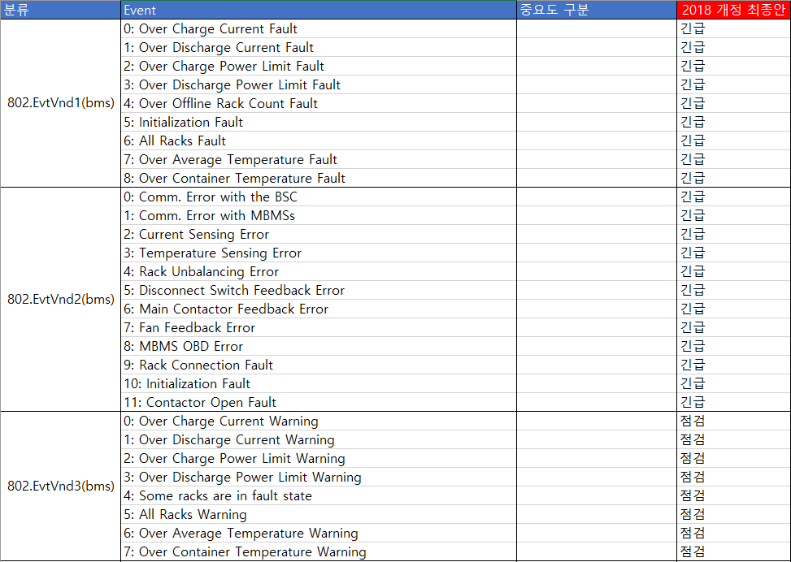
각 필드별 구성 (Event:BMS)
*EMS event_20181004_개정 최종안.xlsx 참고

Slide 20
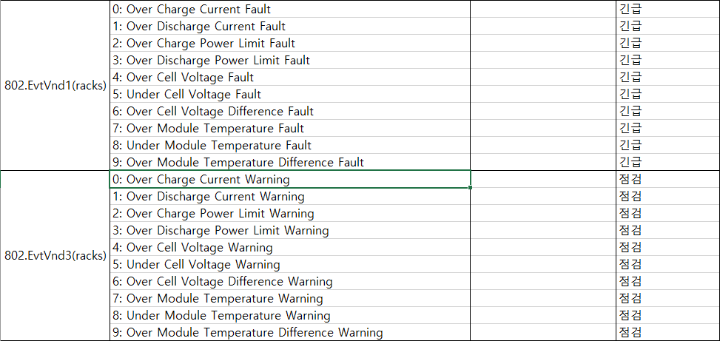
각 필드별 구성 (Event:rack)
*EMS event_20181004_개정 최종안.xlsx 참고

Slide 21
시험 parser
import pandas as pd
import csv
import json
import os
import matplotlib.pyplot as plt
import matplotlib as rc
from sklearn.preprocessing import MinMaxScaler
folder_name = './dataset/data1/ems/30' # site-name
#folder_name = './dataset/sample' # site-name
font_size = 20
target_device = ['bms','pcs--ess']
target_id = {'802':['A','AChaMax','ADisChaMax','SoC','SoH','V'], '1803':['VCell','VCellMax','VCellMin'], '113':['DCA','DCV','DCW','VAr','W']}
target_value = {'bms':['802','1803'],'pcs--ess':['113'] }
plot_title = '_'.join(target_device)+'_'+'_'.join([key for key in target_id])
def file_read():
listOfFiles = list()
for (dirpath, dirnames, filenames) in os.walk(folder_name):
listOfFiles += [os.path.join(dirpath, file) for file in filenames]
listOfFiles.sort()
return listOfFiles
def make_list(): # data frame column 구성에 사용
tot_list = []
for td in target_device:
tv = target_value[td]
tv_list=[]
for i in tv:
ti = target_id[i]
#target=json_data[td].loc[i]
ti_list = []
for j in range(len(ti)):
#ti_list.append(ti[j])
ti_list.append(td+'_'+str(i)+'_'+ti[j])
tv_list.extend(ti_list)
tot_list.extend(tv_list)
return tot_list
def feature_ext(json_data):
tar_list=[]
for td in target_device:
tv = target_value[td]
tv_list=[]
for i in tv:
ti = target_id[i]
#print(td,i)
target=json_data[td].loc[int(i)]
ti_list = []
for j in range(len(ti)):
ti_list.append(target[ti[j]])
tv_list.extend(ti_list)
tar_list.extend(tv_list)
#print(tar_list) # total_list
return tar_list
def list2pd(tar_list, df):
pdf = pd.DataFrame(tar_list, columns = make_list()) # column head 수정
pd_con = pd.concat([pdf, df['timestamp']], axis=1)
return pd_con

Slide 22
시험 parser
def feature_save(tar_frame):
save_fname = plot_title + '.pickle'
if os.path.exists(save_fname):
print('Warning!! The same file name exists. If you are sure you want to create a new file, delete the file first. ')
return
else:
get_ipython().run_line_magic('time', 'tar_frame.to_pickle(save_fname)')
print('A new file will be created. ')
return
tar_frame = pd.DataFrame()
def main():
global tar_frame
file_list = file_read()
for file_name in file_list :
tar_list = []
data = pd.read_csv(file_name, names=['bms', 'timestamp'])
df = pd.DataFrame(data)
print(file_name)
tar_list = []
for json_raw in range(len(df.index)):
try:
json_data = pd.read_json(df['bms'].iloc[json_raw]) # json_data : pandas format
tar_list.append(feature_ext(json_data))
except ValueError:
pass
tar_frame = tar_frame.append(list2pd(tar_list, df)).reset_index(drop=True)
feature_save(tar_frame)
visualization1(tar_frame)
visualization2(tar_frame)

Slide 23
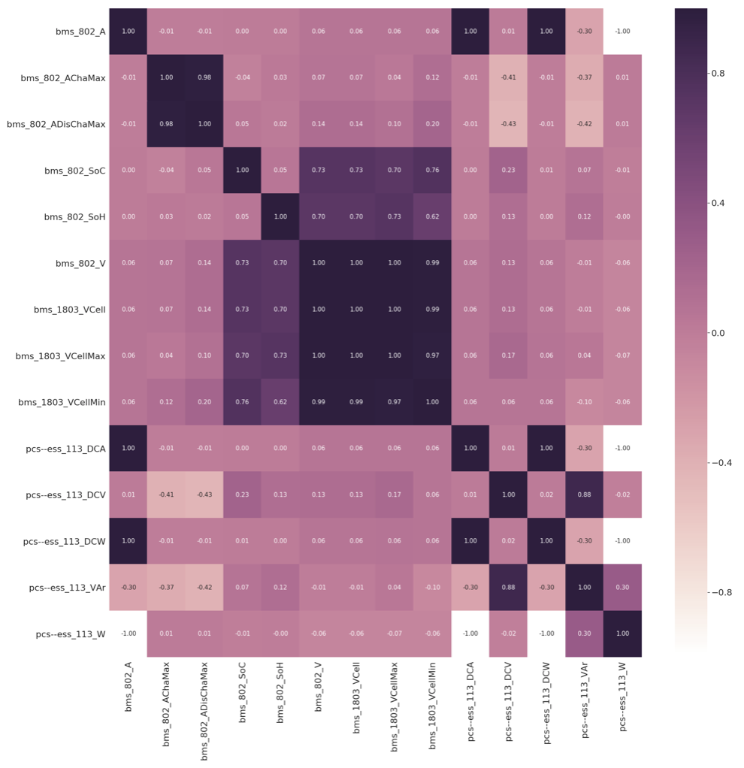
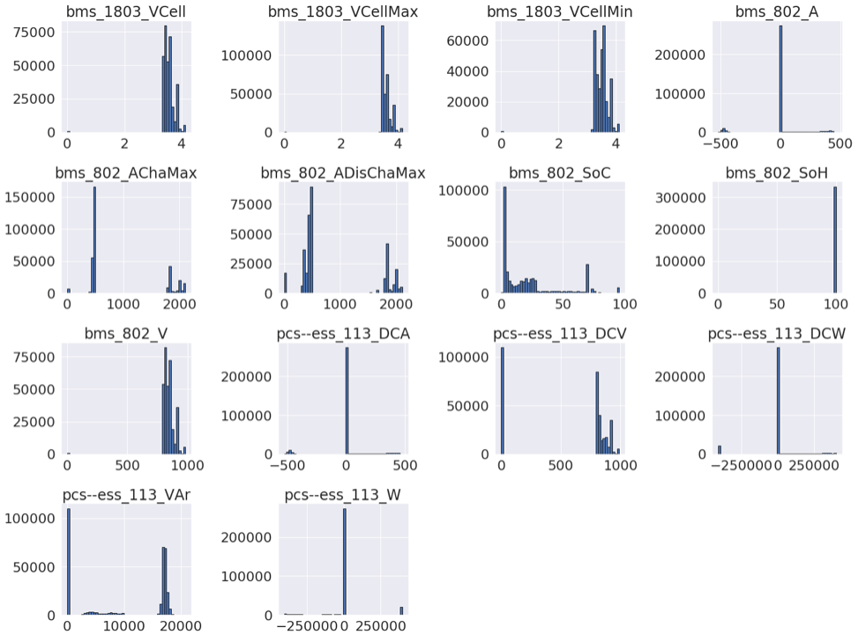
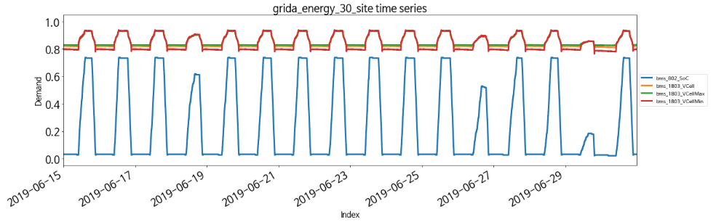
전처리 시험

Slide 24
향후 일정 논의
ESS-PCS 데이터 서버 구축 관련 논의
호남권연구센터 1층 서버룸에 구축하는 방안 논의 (which rack)
데이터 분석을 위한 데이터 gathering 및 전처리 방안 논의
Firewall 우회방안 논의

Slide 25
감사합니다.
Q & A

